Slide 1
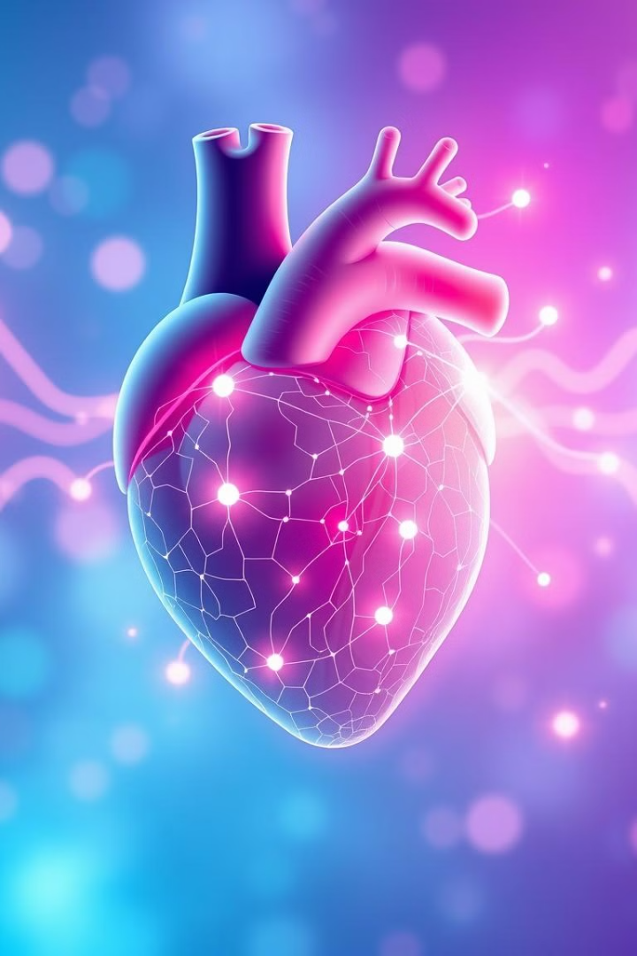
AI and Machine Learning in Heart Disease Diagnosis and Management
This presentation explores the real-time application of AI in heart disease detection and management.

Slide 2
Introduction to Heart Disease and AI/ML
Heart Disease
AI/ML in Healthcare
A broad term for various heart conditions, with Coronary Artery Disease (CAD) and Acute Myocardial Infarction (AMI) being the most common.
AI and ML algorithms are increasingly used to assist healthcare providers in improving diagnostic accuracy, predicting disease outcomes, and personalizing treatments.

Slide 3

Case Overview and Patient Information
Patient Demographics
Medical History
Age: 62 years, Gender: Female, Occupation: Retired teacher.
Hypertension, high cholesterol, family history of heart disease.
Presenting Symptoms
Risk Factors
Chest pain, shortness of breath, fatigue, dizziness.
Hypertension, high cholesterol, sedentary lifestyle.

Slide 4
Role of AI/ML in Heart Disease Diagnosis
Machine Learning for Early Detection
AI in Imaging
ML algorithms can analyze a patient’s medical history and current health data to predict the likelihood of a heart attack or other cardiac events.
Deep Learning Algorithms are used to analyze medical imaging (e.g., CT scans, MRIs, echocardiograms) to identify coronary blockages and heart abnormalities.

Slide 5
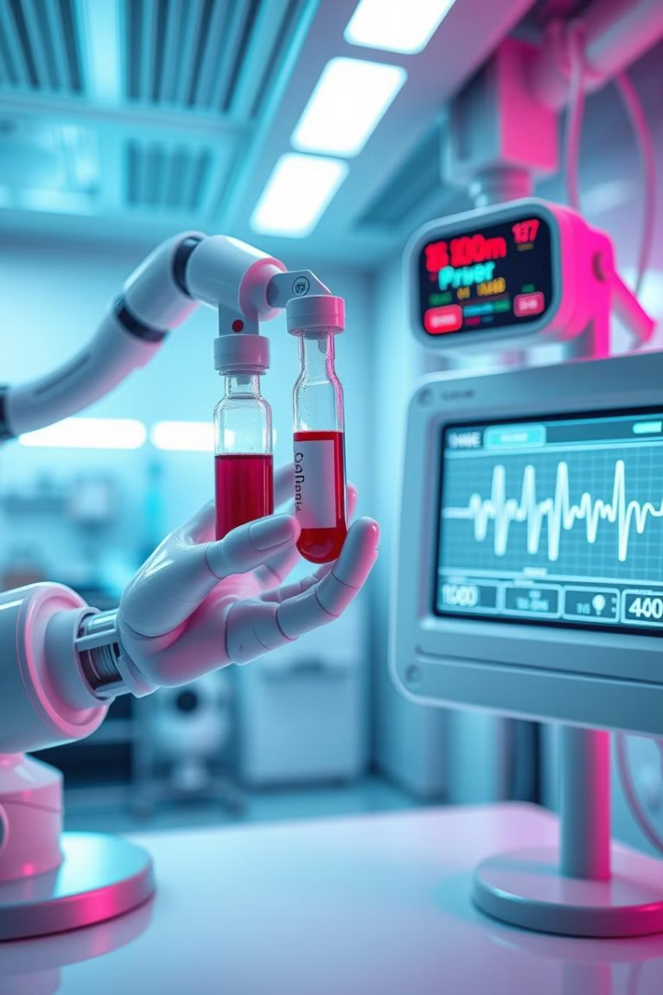
Diagnostic Tests Enhanced by AI/ML
1
Electrocardiogram (ECG)
2
Blood Test Analysis
ML models can analyze trends in biomarker levels (e.g., troponin, CK-MB) to predict heart attack risk, even before clinical symptoms manifest.
A deep learning model analyzes ECG readings in real-time, detecting abnormalities like arrhythmias, ischemia, and potential heart attacks.
3
Coronary Angiography
AI algorithms analyze angiography images to detect coronary artery blockages with more speed and precision than human radiologists.

Slide 6
AI-Powered Treatment Plan
Personalized Medicine
Predicting Drug Efficacy
AI/ML models can help healthcare providers recommend personalized treatment plans based on the patient’s individual health profile, including drug responses.
ML models can predict how the patient will respond to specific heart disease medications (e.g., statins, beta-blockers), minimizing trial-and-error in prescribing.

Slide 7



Real-Time Monitoring Using AI
Wearable Devices
Telemedicine
AI-powered wearable devices, such as smartwatches or ECG monitors, provide continuous monitoring of the patient’s heart rate, blood pressure, and other vital signs.
AI is used in telemedicine platforms to analyze data remotely, enabling doctors to provide continuous care to heart disease patients, particularly in rural or underserved areas.

Slide 8
Outcome and Prognosis with AI Integration
Short-Term Outcome
1
After undergoing AI-assisted diagnosis and treatment, the patient’s condition stabilized.
Prognosis with AI-Enhanced Care
2
The patient’s recovery is expected to be better than traditional methods due to the continuous monitoring and personalized care provided by AI-driven technologies.
Improved Survival Rate
3
Studies show that hospitals using AI for early heart disease detection report higher survival rates and faster recovery times.

Slide 9




Challenges and Limitations of AI in Heart Disease
1
Data Privacy and Security
2
Algorithm Bias
3
Integration with Traditional Systems
4
Doctor-Patient Relationship

Slide 10

Conclusion and Future Directions
Summary
The Future of AI in Cardiology
AI and ML are revolutionizing heart disease diagnosis, treatment, and management.
Continued advancement in AI algorithms and ML models will further improve predictive capabilities, enabling even earlier detection and intervention.
Call to Action
Emphasize the need for integration of AI-driven tools into clinical practice to revolutionize heart disease care, ensuring timely diagnosis, better treatment outcomes, and ultimately saving lives.

